Slide 1
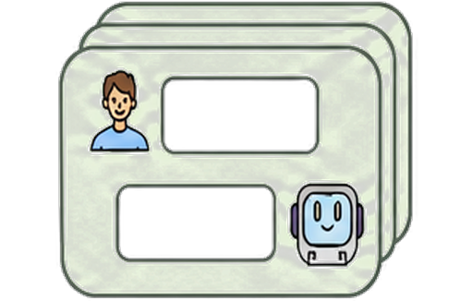









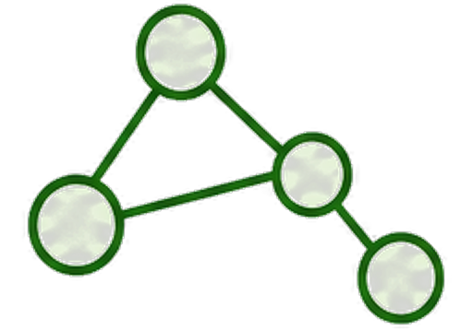

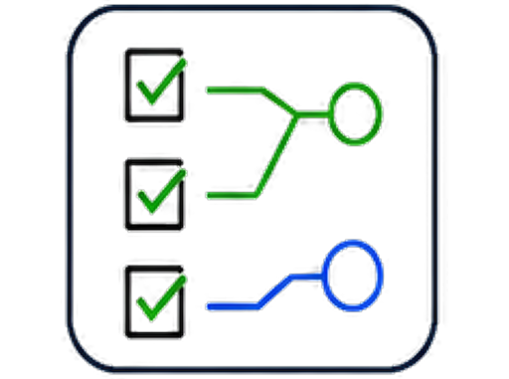



1. Generative Memory
...
... ...
AI
Q
... ...
Compressed
Summary
A
Note
Card
Retrieval over
Interaction History
LLM Abstraction
Generated Memory
Abstractions
Final QA
2. Raw Retrieval
Session-1
Chunks across users/times
... ...
Session-2
Q
... ...
A
... ...
Session-t
Relevant Chunk missed
Lexical / Dense
Interaction History
Retrieve
Retrieval over Raw Chunks
Final QA
3. Our Zero-Mem
?
Entity-context
Graph
... ...
Q
Temporal
A
... ...
hierarchy
Dual Retrieval
Interaction History
Zero-token Construction
Query Profile
& Fusion
Evidence Calibration
Final QA

