Slide 1





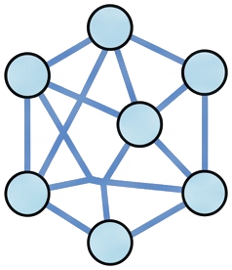




MCTS Affective Flow Construction
1
Role-Based Dialogue Environment
2
MCTS Search Loop
3
Flow Targets
Seeker
Selection (PUCT)
Expansion
Search tree
Flow graph over prefixes
I feel
overwhelmed
a_{t} ~ μ(a | s_{t})
s₀
s₀
Dialogue State
s₀
s₀
state s_{t}
s₁
s₁
Supporter
s₁
s₁
Affirm
and guide
strategy (action)
s₂
s₂
···
s₂
s₂
Datasets
action a_{t}
s₃
···
Rewarder
Backpropagation
s₃
s₃
Reward (4-dim)
0.62
s₀
Rollout L = 3
r_{t} ∈ ℝ⁴
0.58
s₁
s₀
F(s) = Q̂(s)V_{φ}(s)
Σ_{in} F = Σ_{out} F
s₁
···
Empathy
Info
Naturalness
Strategy
0.41
s₂
s₃
0.37
···
s₂
···
s₃
Ĝ(s_{t}, a_{t})
state
selected path
reward
unexplored
AFPO Training and Affective Reasoning
4
Preference + Flow-Balance Learning
5
Lightweight Inference
Policy & Value Model (PLM)
Training signals from MCTS
Paired trajectory fragments
top-K strategies
Score & Rank
winner
a₁
score(a | s_{t}) =
policy π_{θ}
Subpath balance:
s₀
s₁
s₂
s₃
···
choose a_{t}
ΔF_{m,n} ≈ Δπ_{m,n}
a₂
log π_{θ}(a | s_{t}) + V_{φ}(s_{t}, a)
⋮
value V_{φ}
Edge preference:
loser
a_{K}
Q̂(s, a_{w}) > Q̂(s, a_{l})
s₀
s₁
s₄
s₅
···
supportive response
You're doing your best, and
update π_{θ}, V_{φ}
it's okay to take things one
improved
emotional
state
L_{AFPO} = L_{policy} + λL_{evaluate}
step at a time. Let's figure
out what might help today.

